Slide 1

MVIT AN ONLINE MARKET PLACE FOR VITIANS
A PROJECT REPORT
INTERNET AND WEB PROGRAMMING

Slide 2
TEAM MEMBERS
Anuj Mishra | 20BCE2934
Iyashi Pal | 20BCI0295
Medisetti Varaguna Sree Chandana | 20BCE0977
Tarang Gupta | 20BCI0310
Prince Panjiyar | 20BCE2775

Slide 3

ABSTRACT
MVIT is an online shopping website which allows users to buy and sell used items.
It is specially designed for Vitians. It makes selling and buying of things easier and accessible within the campus of VIT.
Online shopping is very popular.
This website is made only for Vitians and takes proper login information to access the portal. This project is developed using ReactJS and MongoDB.

Slide 4
PROBLEM STATEMENT
People throw the used items when they are no longer needed.
These things may be useful to other people.
MVIT gives a platform to the people who want to sell their used items through our website and the people who want to buy the used items.
By using the MVIT website, the sellers are trying to get some money for their used items and the buyers are able to buy the items they need for less cost.
In this way both the seller and the buyer are benefited and the wastage is reduced.

Slide 5
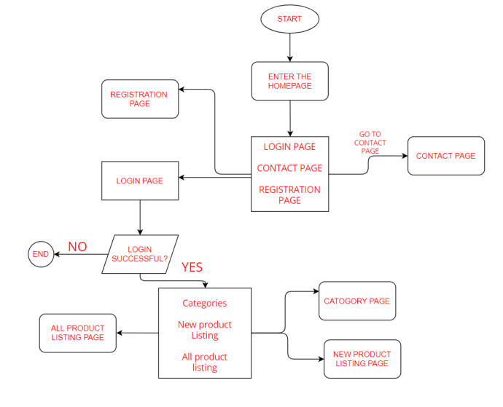
PROCESS FLOW DIAGRAM

Slide 6
MODULES
Frontend
We have used the JavaScript framework, ReactJS for the frontend work on our project.
Homepage
This is the landing page of our website; we display recently posted products and all the available categories of products on this page.
Login and Registration
Login needs the user’s email address and password.
Edit Profile Page
Upon registering based on their basic information, the users have a chance to update their profile with important information before they go on and sell or buy products.

Slide 7
MODULES
Posting Items for Sale
All users on the website have a chance to post items for sale on our website. They can do so by filling a form on the “add new product” page.
All Products Page
This page displays all the products that have been posted on our page.
Contact Us Page
This page is for the users to ask questions or post in queries, if any, about the website.
Support Requests Viewing Page
This page is for the admin users to view all the incoming support requests.
Support Requests Answering Page
This page is used by the administrator to answer all the queries which are viewed in the support requests page.

Slide 8
MODULES
Backend
In our project, for the backend, we have used ExpressJS and NodeJS Frameworks of the JavaScript language.
We used MongoDB Atlas as the database. It is hosted on a cloud platform. We deployed our backend on Heroku and frontend on Vercel.
In the next section, we briefly describe the various models we used for the database in our project.

Slide 9
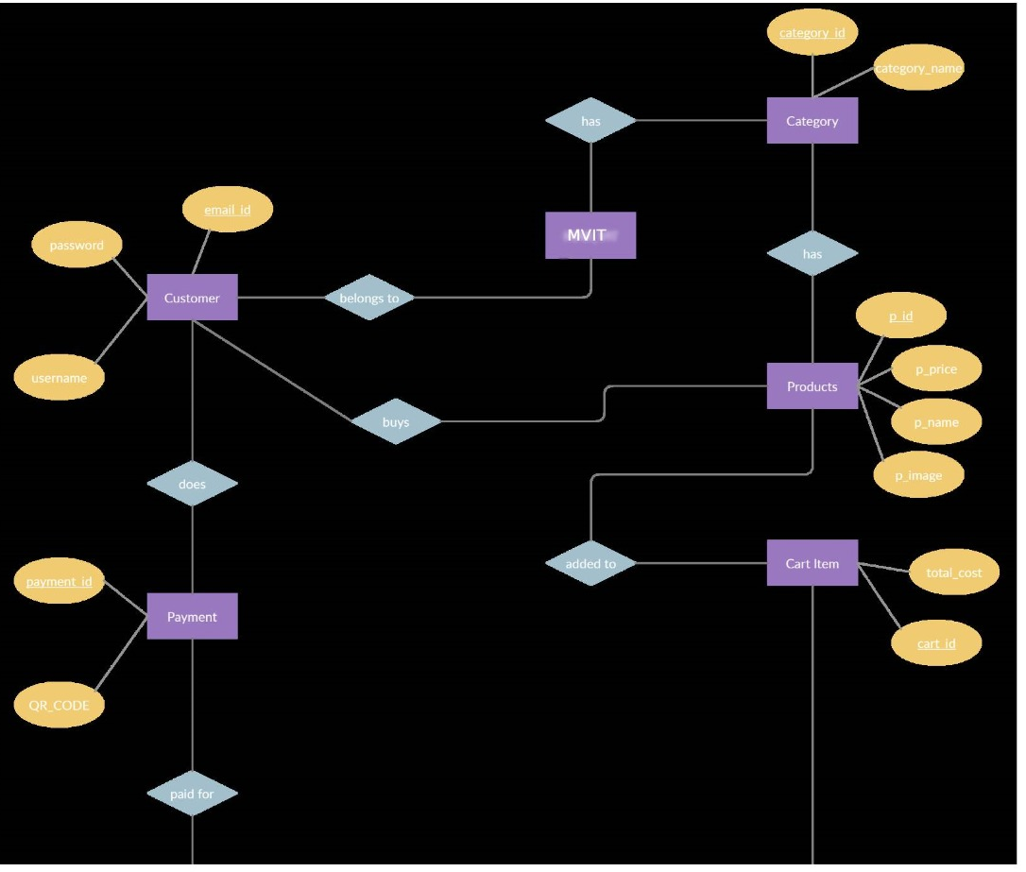
DATABASE DESIGN -ER DIAGRAM

Slide 10
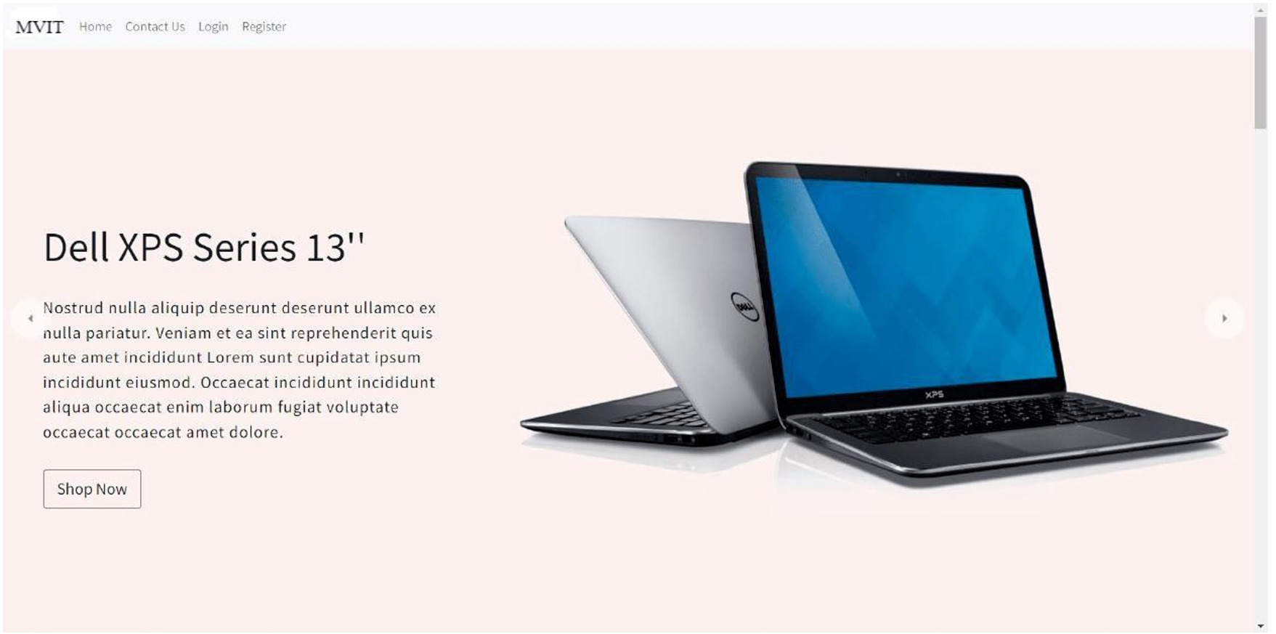

Slide 11
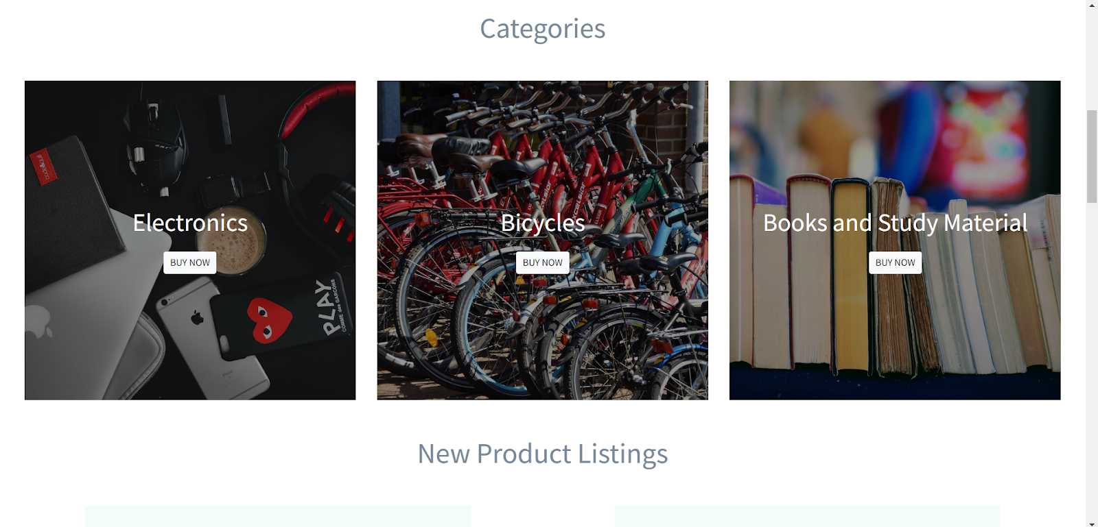

Slide 12
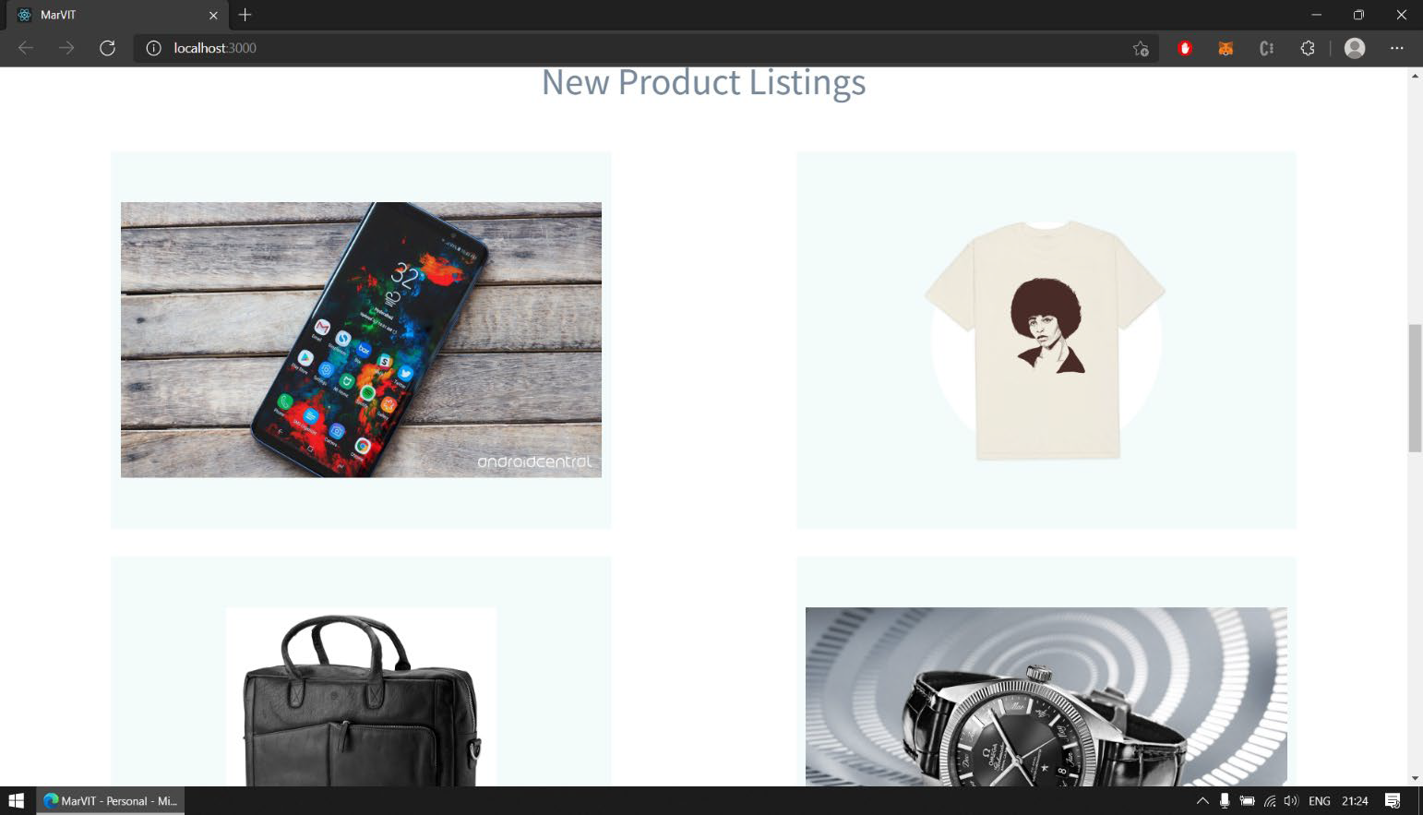

Slide 13
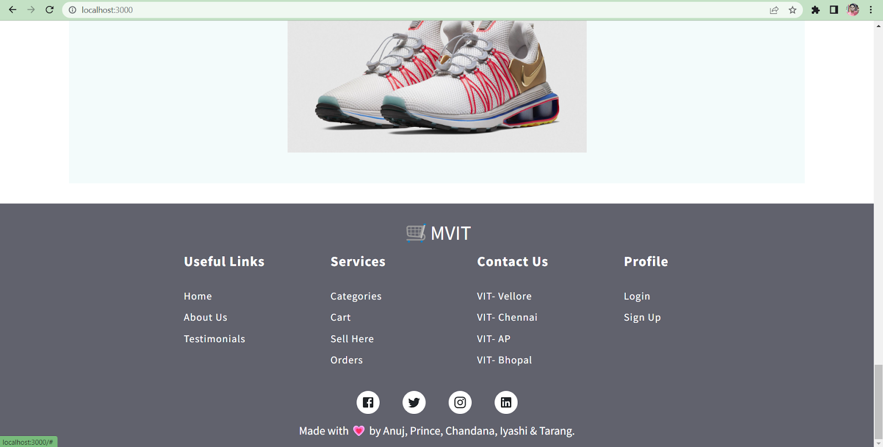

Slide 14
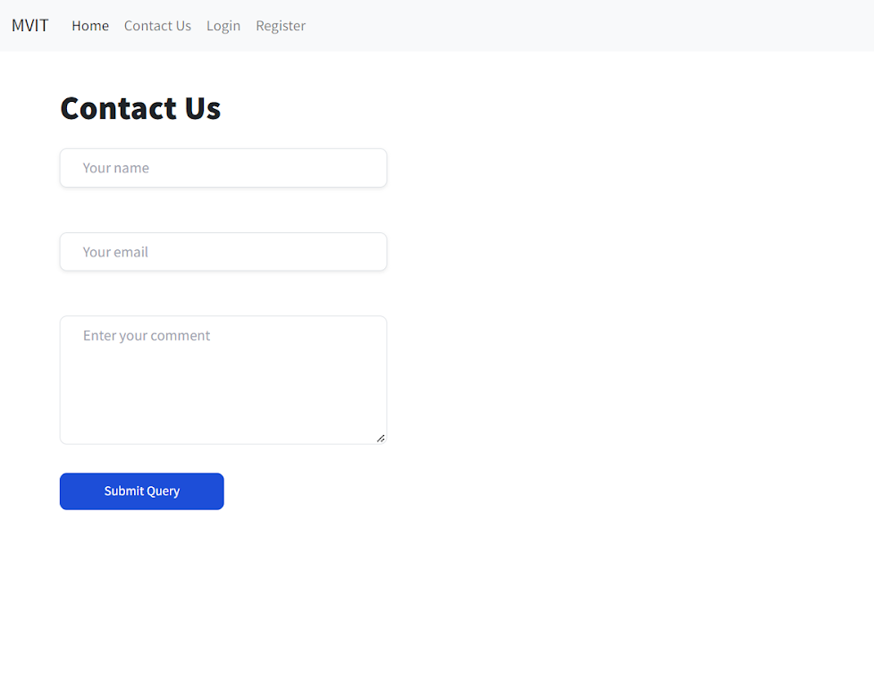

Slide 15
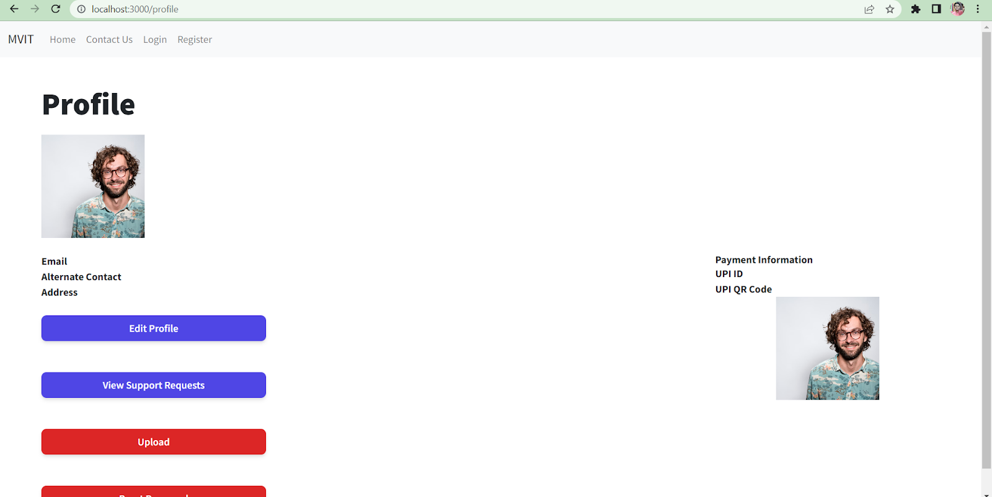

Slide 16
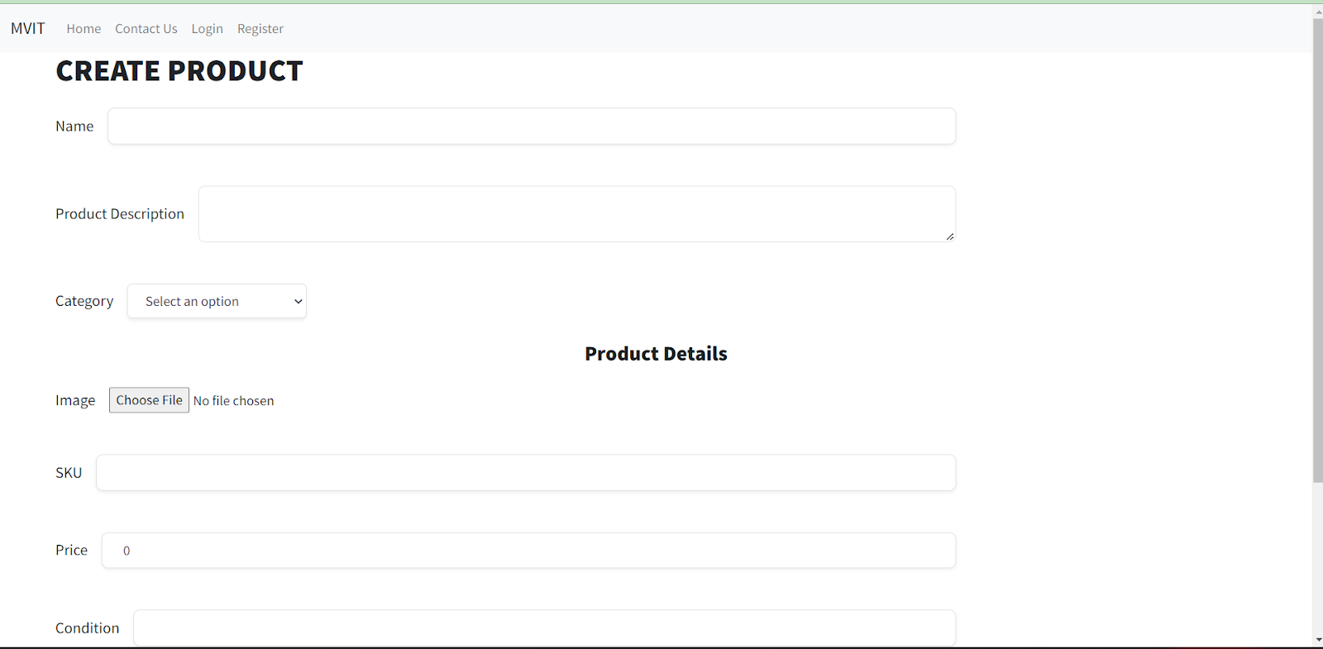

Slide 17

THANKYOU

